Slide 1
WORLD OF DRONE
Drone Application: Entertainment

Slide 2
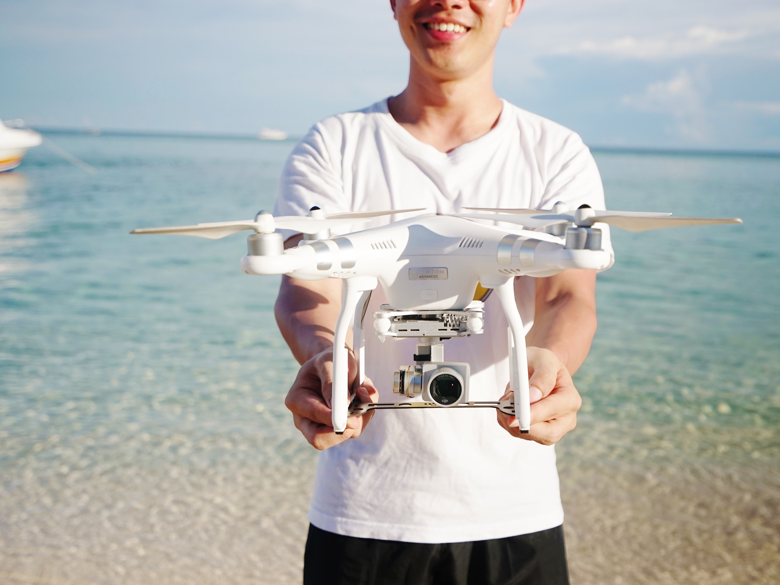
Drone Application: Entertainment
Small UAV have been flown by hobbyists since the earliest days of manned flight.

Slide 3
Drone Application: Entertainment?
In the United States, hobby and recreational use of such UAS is permitted according to some RULES

Slide 4
Drone Application: Entertainment?
When operated in accordance with a community-based set of safety guidelines and nationwide community-based organizations;
when limited to not more than 55 pounds (with exceptions);

Slide 5
Drone Application: Entertainment?
Without interfering with and giving way to any manned aircraft;
Within 5 miles of an airport only after notifying air traffic control.

